Slide 1
Shir Hadash Customer Focus Study
Developing a model for guiding the development & delivery of superior products & services

Slide 2
Outline
Current State
Objectives
Benefits
Program Charter
Program Roadmap
Program Governance
Staffing Plan
Funding Plan
Project 1 Overview

Slide 3
Current State
Customer value delivered by EA is difficult to identify and measure.
Business case for justifying EA investments is challenging to create without hard metrics around cost reduction, cycle time reduction, and value enablement.
EA resources are inconsistently positioned to influence the planning, investment, and execution around change.
Organizations do not know how best to use EA resources to enable and create value for their customers and stakeholders.
EA resources do not have a consistent way to assess the impact of their contributions (short term and long term).

Slide 4
Objectives
Create a reference model for defining the EA jobs from which duties, practices, and value are derived.
Build a repository of metrics that CEAEP can use to measure the value that EA delivers to customers (governance).
Map the value metrics against the EA services (practices & methodologies) and EA products (tools & deliverables) used to deliver value to customers.
Identify opportunities (gaps between what is delivered versus what customers want) to improve EA services & products.
Identify products & services that CAEAP can deliver to help:
Certified EA’s optimize their value delivery
Stakeholders leverage EA to optimize their value delivery

Slide 5
Benefits
Practice:
EA’s will be able to justify the value of their services by creating measureable lineage from products & services to addressing customer needs.
Profession:
CAEAP will be able to align the value gaps with its roadmap to ensure the practices, certification, education, and governance support the unmet customer needs for EA products & services.
Public:
Enterprises will be able to understand the need, value, and positioning for EA to augment their own value delivery of products and services.

Slide 6
Program Charter
Program Charter | Developing EA Value Model
Project Number | CAEAP - 003 | Charter Date | August 1st, 2009
Program Sponsor | CAEAP BOD BOT | Program Director | Jeff Wallk
Program Scope | Design and implement a customer focus framework for capturing and modeling metrics used to model the outcomes for customers and a set of metrics for which to benchmark the products & services delivered by EA practitioners.\
Objectives | Implement a customer focus methodology Create a reference model for identifying customer outcomes and metrics for measuring value Define a complete list of jobs performed by an EA Create a repository of customer outcomes & value metrics Develop a process to prioritize and align the outcomes & metrics with GAPS in CAEAP practices Institutionalize the customer focus methodology within CAEAP Develop a licensing program to promote the usage of EA Value metrics & drive revenue for CAEAP
Governance | Establish a steering committee with members from the BOD and Practice Worksttream Create a small team of dedicated trained resources to staff each project Project lead will be the Program Director Steering Committee will approve scope, program objectives, and project deliverables (Note: Each project represents 1 job that will be studied to capture the EA outcomes & value metrics

Slide 7
Program Roadmap
Q3 2009
Draft the proposal for the work stream
Obtain approval from CAEAP leadership
Build a steering committee for the program
Secure funding for the first project
Q4 2009
Continue securing funding for the project
Draft resources for the project team
Finalize project schedule
Begin work on initial deliverables

Slide 8
Program Roadmap
Q1 2010
Complete qualitative study for Project 1
Complete quantitative study for Project 1
Conduct analysis of Project 1 results
Q2 2010
Present Project 1 results to CAEAP leadership
Publish results for Project 1 to Public
Capture feedback and gauge response
Review program with Steering Committee for next steps
Secure funding for additional projects per program
Q3 2010
Move forward with next project(s)

Slide 9
Program Governance
BOT
BOD
Program
Steering Committee
Program
Director
CAEAP
President
CAEAP
President

Slide 10
Staffing Plan
Steering Committee
Jeff Wallk
Mark Lane
Greg Black
Marc Paradis
Mark Sternberger
Project Team
Jeff Wallk (commitment of 10 hours / week)
Volunteer 1 (commitment of 6 hours / week)
Volunteer 2 (commitment of 4 hours / week)

Slide 11
Funding Plan
Sell future shares for the licensing for access to the EA value metrics to fund the initial project.
Initial pricing for licensing of the EA Value Repository has not been set. However, the value will increase as the data from each project flows in.
Future shares for access to the repository will be set at:
$25,000 for enterprise license (3 year access)
Funding for the ongoing program will be established with a more formal licensing model (elaborate further on bullet 3).

Slide 12
Project 1
(Overview)

Slide 13
Key Milestones
Define domain model
Define customer focus methodology
Define action plan to capture unmet needs
Begin interviews with key stakeholders
Complete qualitative analysis
Draft survey for quantitative analysis
Conduct survey and capture data
Present recommendations
Based on the Strategyn Methodology (see next slides)

Slide 14
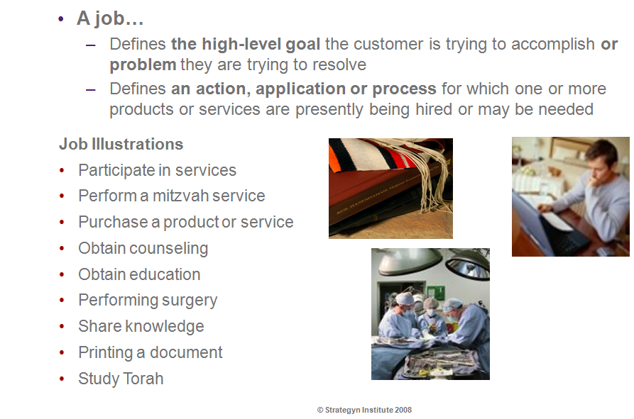
What is a Job ?

Slide 15
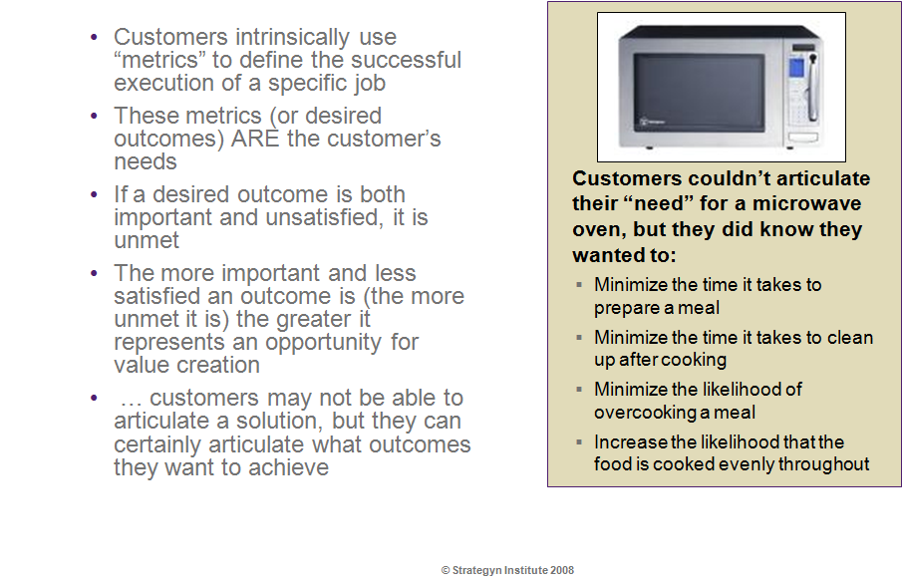
What are outcomes ?

Slide 16
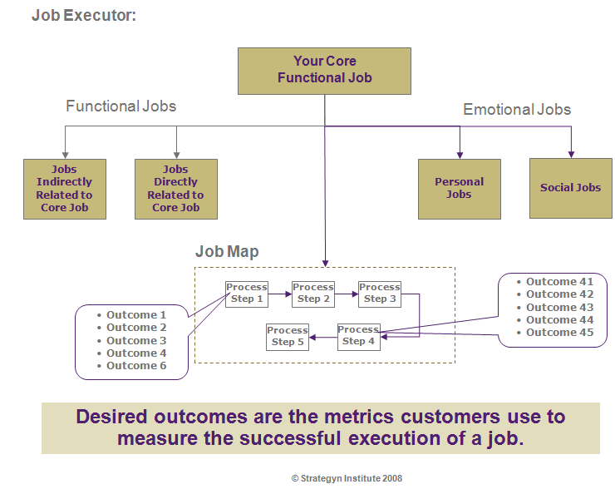
Model for Relating Jobs & Outcomes

Slide 17
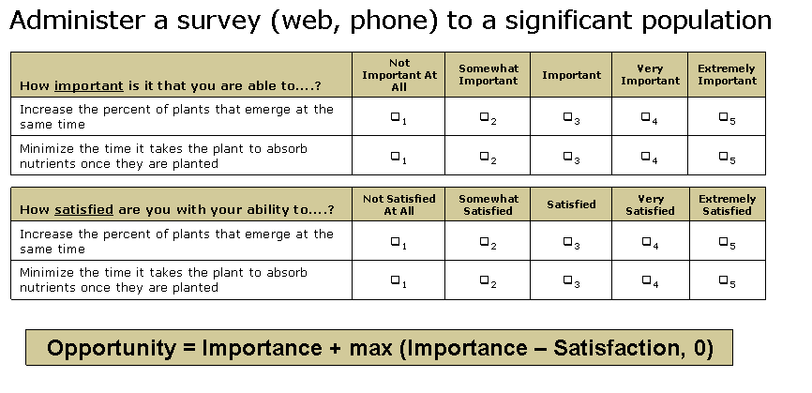
Capturing & Measuring Value

Slide 18
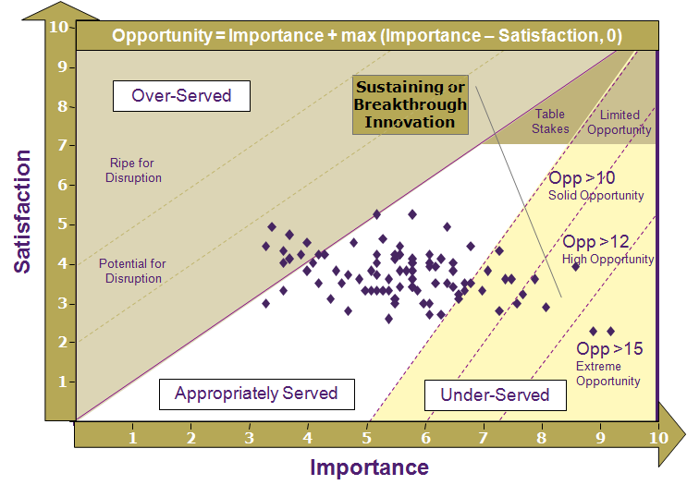
Identifying & Prioritizing Opportunities

Slide 19
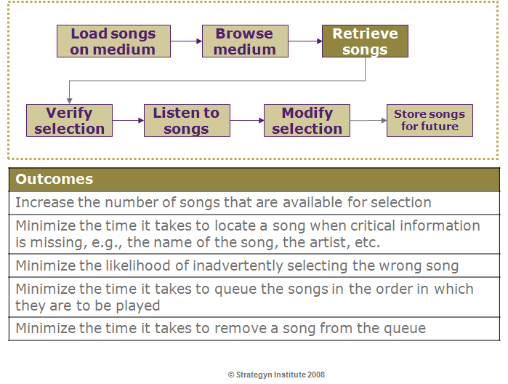
Example: Job of Storing & Retrieving Music

